Slide 1
Arduino WeMos Board Wifi example

Slide 2
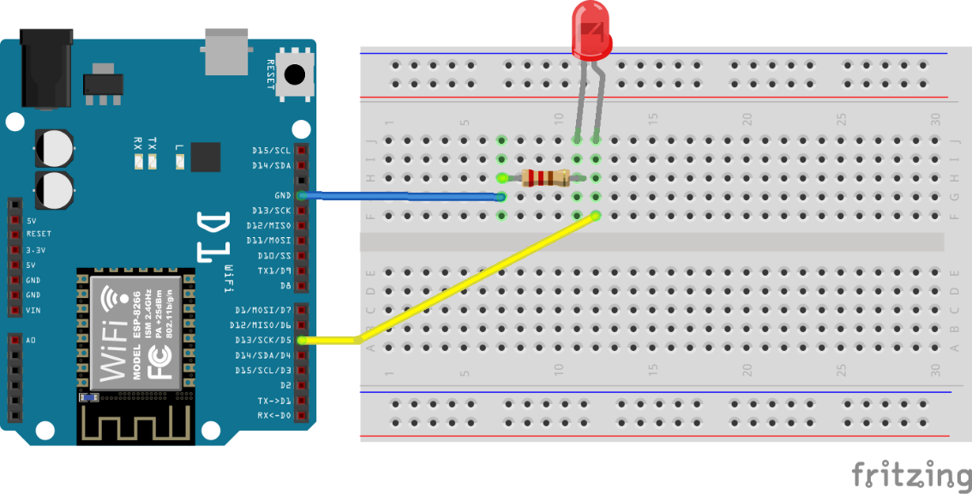
Arduino WeMos Board Wifi example
STEP 1
Please connect as follows.

Slide 3
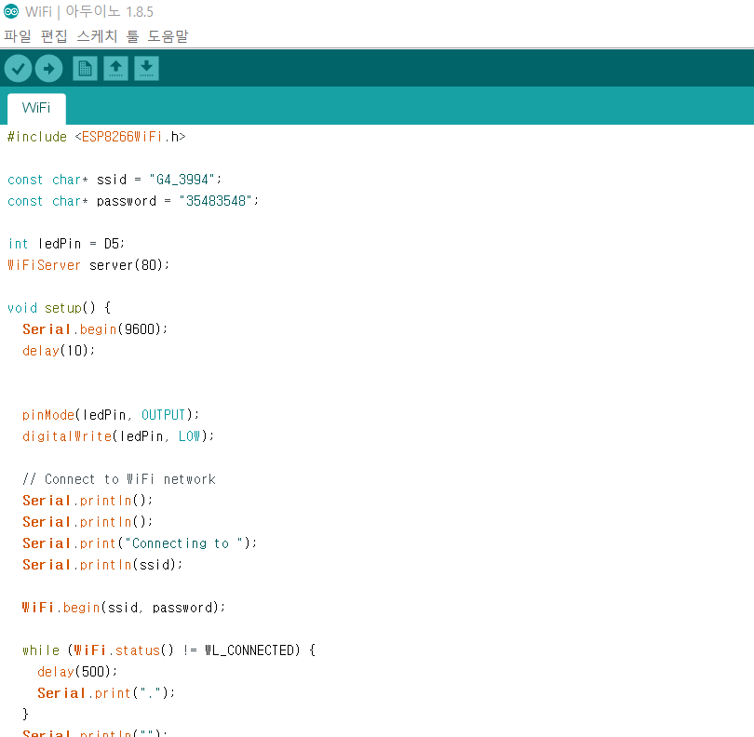
Arduino WeMos Board Wifi example
STEP 2
Please add the library(ESP8266Wifi.zip) provided and Copy the provided code.

Slide 4

Arduino WeMos Board Wifi example
STEP 3
Please put SSID and PASSWORD of WiFi in the CODE

Slide 5
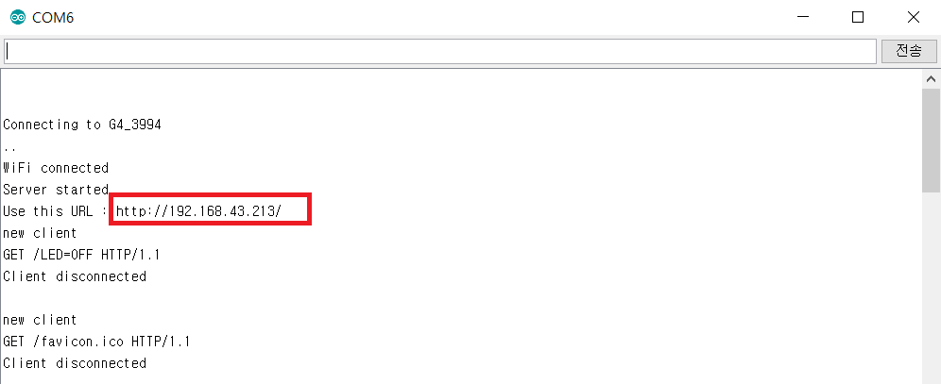
Arduino WeMos Board Wifi example
STEP 4
After running it, turn on the serial monitor. (If Wifi connected appears, it is connected.)
Please. remember the following IP.

Slide 6
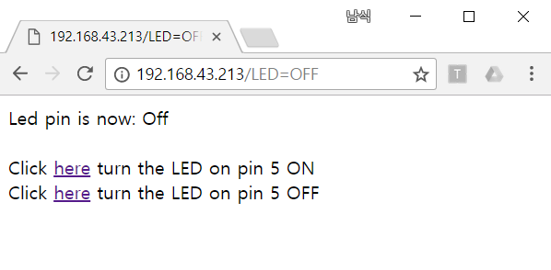
Arduino WeMos Board Wifi example
STEP 5
Type in the IP. If text appears as shown below, LED control is possible.

